Slide 1
INDUSTRIAL SYSTEMS GROUP
Portfolio Presentation

Slide 2

ABOUT US
Industrial Systems Group (ISG) is dedicated in developing it’s own set of corporate performance competencies, aimed to achieve excellence in every project we deal with and deliver the highest level of performance.
ISO 9001:2015 Management System Certified
ISO 14001:2015 Environmental Management System Certified
OHSAS 18001:2007 Health & Safety Management System Certified
DEKRA Production Quality Assurance Certified: IECEx and ATEX
UL Listed Products
Manufacture/Customize Classified and Un-classified Electrical Equipment, Cable management system, Transformers and Cutout switches, etc.
ISG has 18,700 m² air-conditioned manufacturing area.
118 Qualified & Trained Staff
42% are Saudi Nationals
The company is committed to assist customers to achieve their operational excellence in the Middle East by providing services and solutions as per international standards and requirements.
The goal of INDUSTRIAL SYSTEMS GROUP is to meet client's needs accurately, correctly, first time, every time at the right place, and in the required time, also to carry out work which consistently satisfies the requirement of our clients and all applicable Saudi regulations, codes of practices & laws.
Our strategy is to focus on:
Customer satisfaction
Continual improvement of QMS as per ISO 9001:2015.
Improvement in business process including development of Human Resources.
Setting SMART quality objectives in line with this policy.
It is ensured this policy is understood, implemented and maintained at all levels in the factory by providing appropriate training to all personnel. Statement of quality policy is displayed at prominent locations in the factory to increase awareness among the employees and also available to relevant interested parties as appropriate.

Slide 3
PRODUCTS & SOLUTIONS
ELECTRICAL SYSTEMS
PROCESS ANALYTICAL SYSTEMS
CONTROL & SAFETY SYSTEMS
Low Voltage Panel Boards
Low Voltage Outdoor Switch Racks
Lighting Fixtures and Accessories
Enclosures & Junction Boxes
Controls and Push Button Stations
Plugs & Sockets
Analyzer Shelter
Sampling System
System Integration
Process Gas Chromatograph
Physical Properties Analyzers
HydroCarbon Gas Analyzer
Flue Gas Oxygen & Combustion Analyzer
CEMS & AQMS Analyzers
Environmental & Process Data Management System
Analyzer Management System
Water Quality Analyzers
Steam & Water Analysis System (SWAS)
Oil in Water Analyzers
Vibration Monitoring System (VMS)
High Integrity Pressure Protection System (HIPPS)
INSTRUMENTATION
NON METALLIC PRODUCTS
METAL WORK & FABRICATION
Remote Terminal Unit (RTU)
Wireless Remote Monitoring Unit (WRMU)
Thermocouples
Resistance Temperature Detectors
Thermowells
GRP/FRP Cable Management
Structural Design and Fabrication
Sheet Metal Design and Works

Slide 4
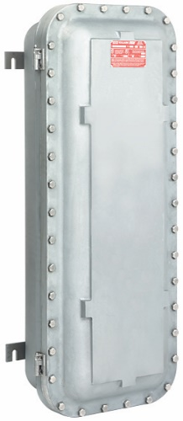
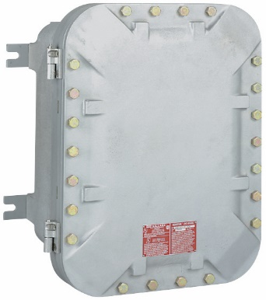
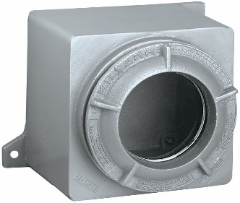
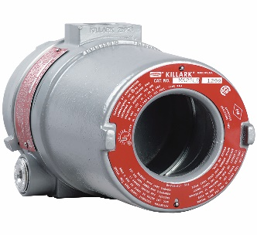
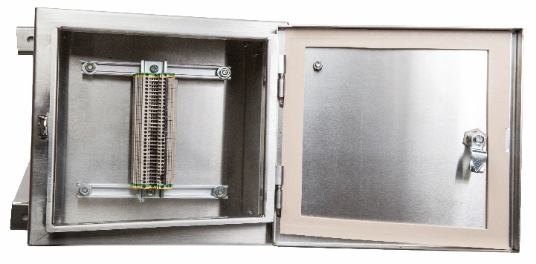
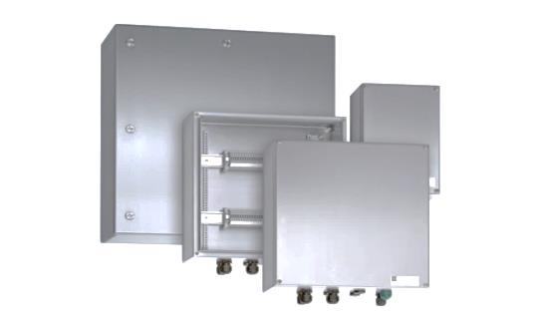
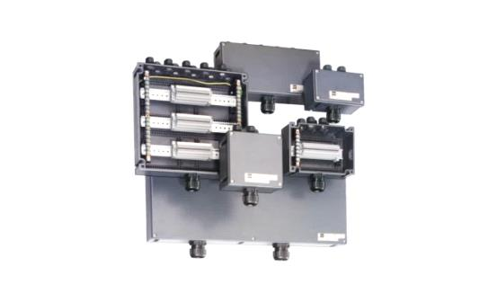
ENCLOSURES & JUNCTION BOXES
We offer explosion proof enclosures that built to withstand the harshest of environments, including severe hot and cold ambient temperatures, and designed with safety and reliability at the forefront.. Our line of enclosures includes instrument housings, junction boxes, and terminal boxes, with accessories such as, drains and breathers, operating handles, control operators, viewing windows, and mounting pans.
INSTRUMENT ENCLOSURES
JUNCTION & TERMINAL BOXES
You can simply impress your audience and add a unique zing and appeal to your Presentations. Get a modern PowerPoint Presentation that is beautifully designed. I hope and I believe that this Template will your Time, Money and Reputation.

Slide 5

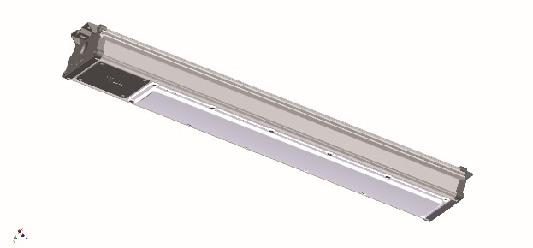
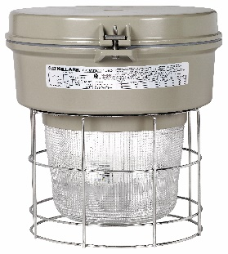
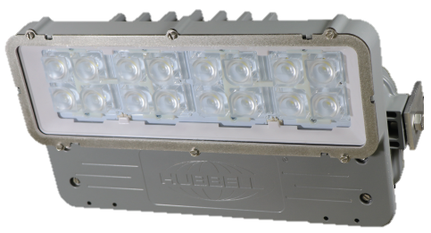
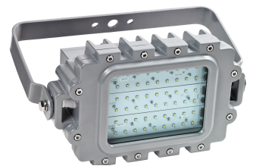
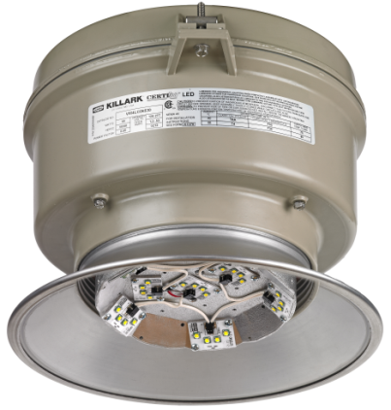
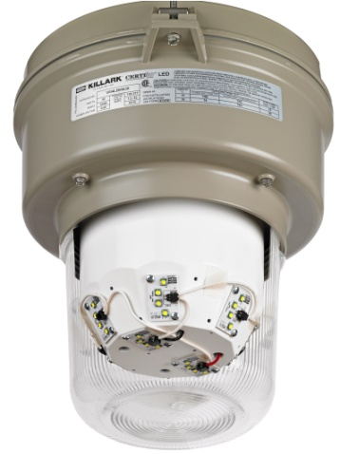
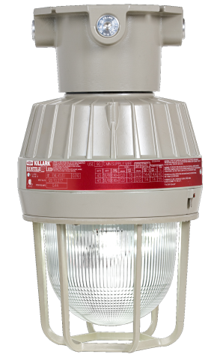
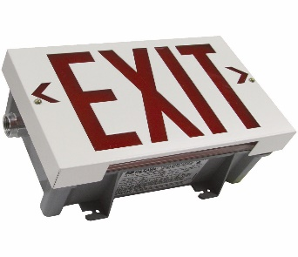
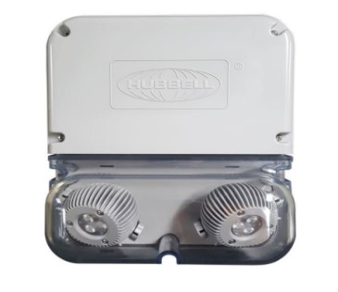
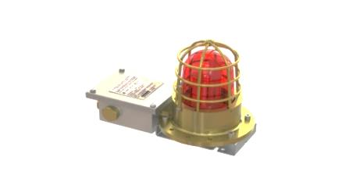
LIGHTING FIXTURES
We provide market leading lighting fixtures with a proven ability to supply cost-effective solutions, with expert support and global certifications. We offer luminaires in a variety of housing types such as copper-free aluminum, fiberglass reinforced polyester, or stainless steel. Our lighting products encompass the latest in long life energy and labor saving LED, HID, and fluorescent technologies.
HARSH & HAZARDOUS LIGHTING
Our explosion proof lighting fixtures can operate in hazardous locations with applicable NEC, CEC, IECEx, and ATEX safety requirements.
INDUSTRIAL LIGHTING
Industrial lighting products including linear lighting, flood lighting, and emergency lighting are designed to meet all industrial location needs.
You can simply impress your audience and add a unique zing and appeal to your Presentations. Get a modern PowerPoint Presentation that is beautifully designed. I hope and I believe that this Template will your Time, Money and Reputation.

Slide 6
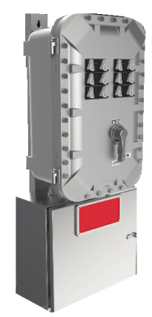
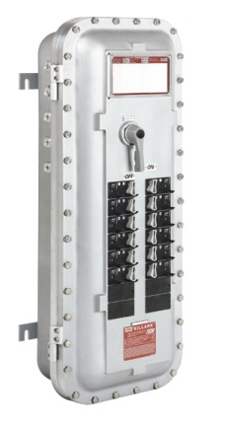
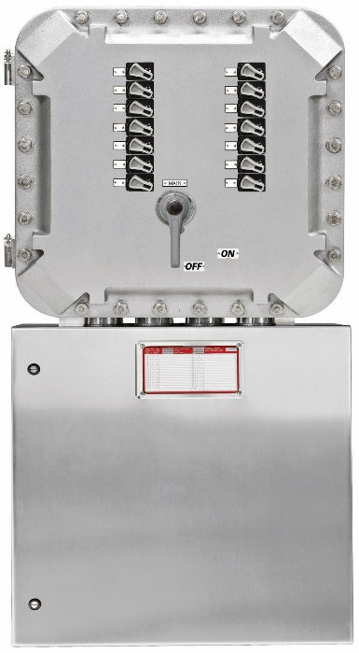
LOW VOLTAGE PANELBOARDS
Our factory sealed panelboards are designed to maintain all of the arcing, sparking and sliding contacts in the cast aluminum enclosure (top enclosure), while the stainless steel 316 industrial grade wiring chamber (bottom enclosure) has the line and load connections wired to terminal blocks.
You can simply impress your audience and add a unique zing and appeal to your Presentations. Get a modern PowerPoint Presentation that is beautifully designed. I hope and I believe that this Template will your Time, Money and Reputation.

Slide 7






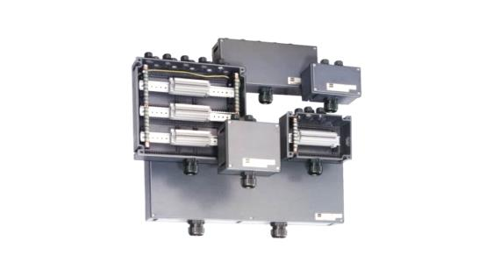
LV OUTDOOR SWITCHRACK
Completely assembled and wired for customer connections to load side of starters and breakers.
Available in single or double sided assemblies per customer specification. All wiring is in accordance with current NEC requirements.
Optional components include: Enclosed Circuit Breakers, metering panels, transformers, Junction Boxes, Control Stations, Meter/Instrument Enclosures, Ground Detection, Receptacles, Photocells, Light Fixtures, Transformers, Space Heaters.
Frame is all welded construction made of aluminum or hot dipped galvanized steel.
Optional bus enclosure is made of painted steel or stainless steel.
Bus bars are available in bare or insulated copper
You can simply impress your audience and add a unique zing and appeal to your Presentations. Get a modern PowerPoint Presentation that is beautifully designed. I hope and I believe that this Template will your Time, Money and Reputation.

Slide 8
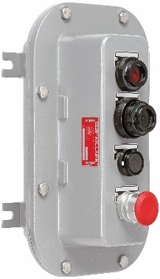
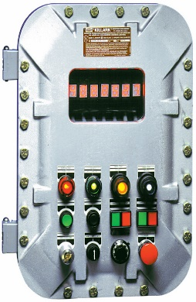
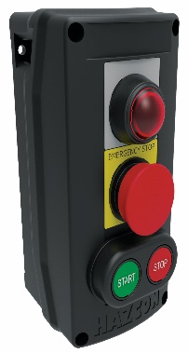
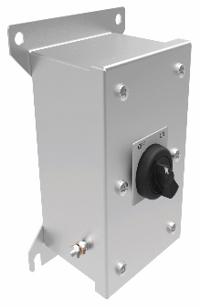
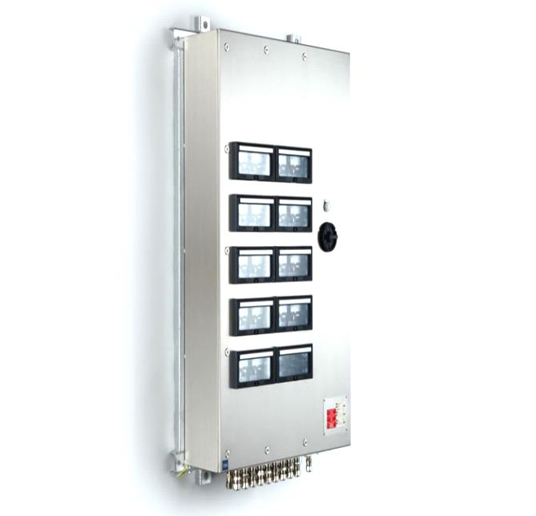
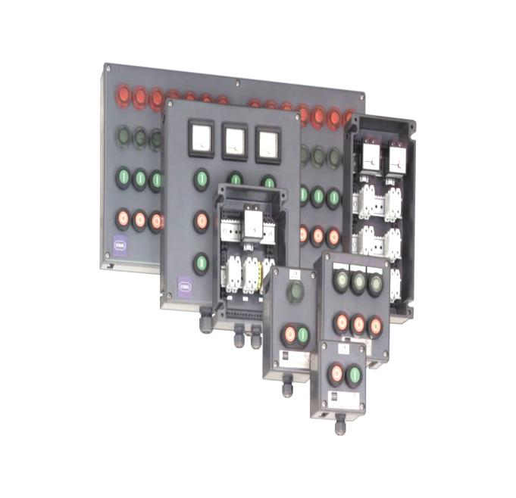
CONTROLS & PUSH BUTTON STATIONS
Our control stations and accessories for hazardous locations are designed to contain explosions, prevent outside pollutants from getting in, and allow electrical energy to be safely distributed and controlled. Our control stations work to protect against water ingress and corrosion in addition to being factory sealed for ease of installation. Our range of explosion proof products includes control stations, back boxes, covers, GFCI devices, actuators, operators, indicating lights, tumbler switches, fire alarms and more.
You can simply impress your audience and add a unique zing and appeal to your Presentations. Get a modern PowerPoint Presentation that is beautifully designed. I hope and I believe that this Template will your Time, Money and Reputation.

Slide 9
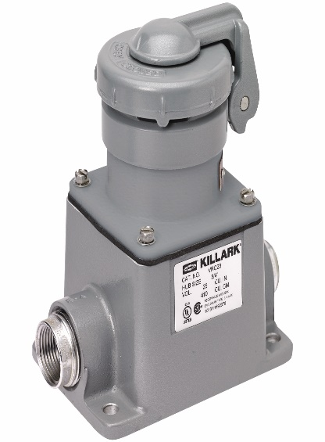
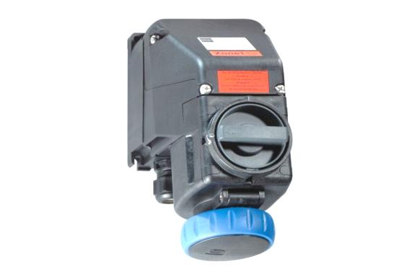
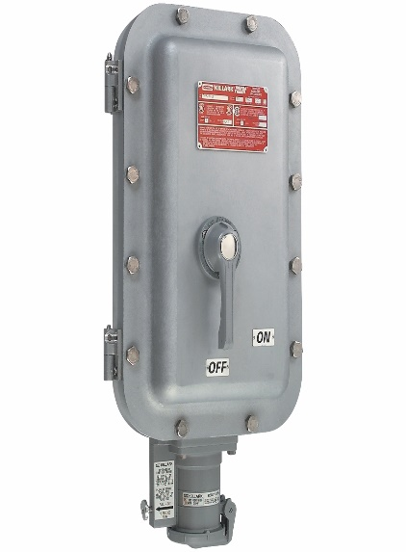
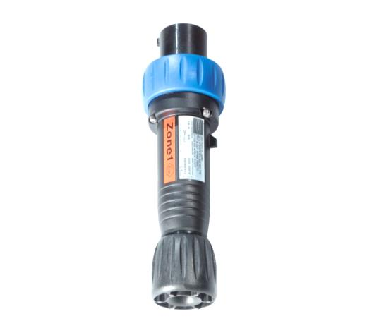
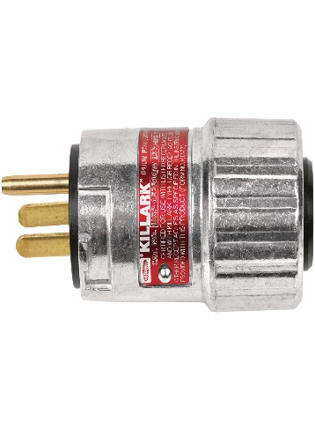
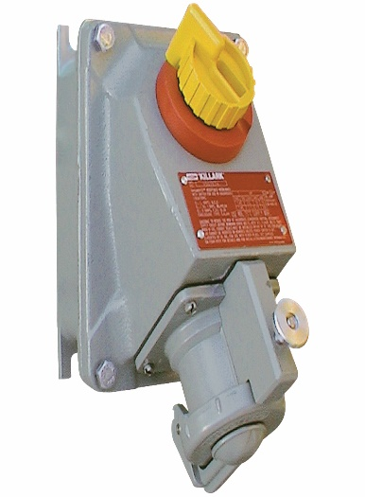
SOCKETS & PLUGS
Explosion proof wiring devices are designed to meet all of your electrical installation needs. We offer cutting-edge products designed for the harshest environments with a variety of materials and designs to ensure you get the products that meet your needs and NEC / IEC standards.
You can simply impress your audience and add a unique zing and appeal to your Presentations. Get a modern PowerPoint Presentation that is beautifully designed. I hope and I believe that this Template will your Time, Money and Reputation.

Slide 10
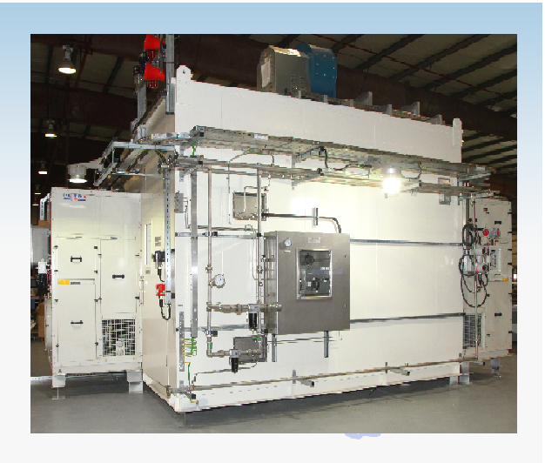
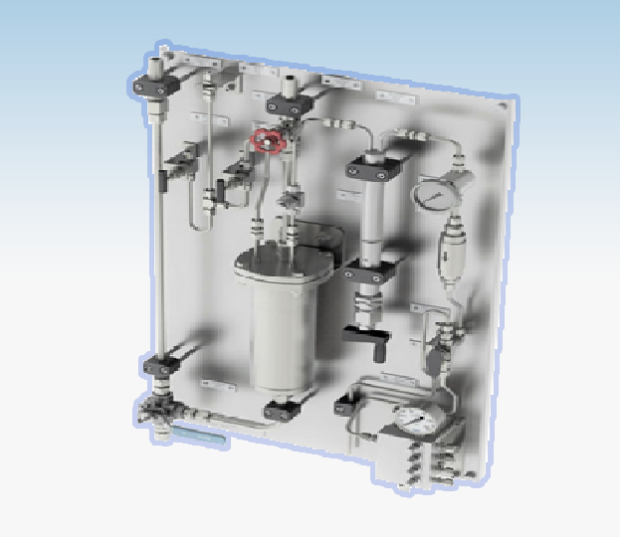
PROCESS ANALYTICAL SYSTEMS
Analyzer Shelter
ISG build Shelter and supply bespoke pre-fabricated shelter per application and Environmental requirements. Shelter integrated with Analyzers and Sample Conditioning Systems in compliance with Industrial standards and area classification .
Sampling System
Custom-built sample conditioning systems based upon proven design & techniques per analyzer application needs & in-line with industrial standard to meet requirement of Chemical, Oil, Gas Refinery & Petrochemical process industries.

Slide 11
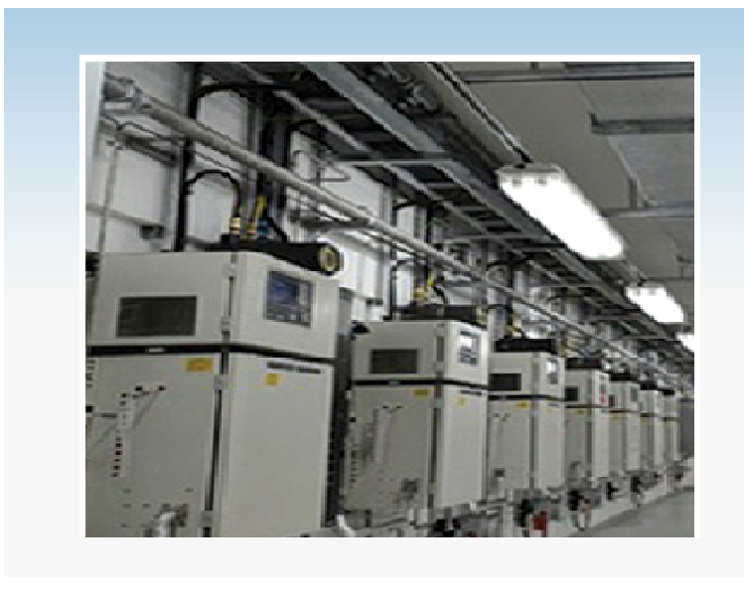
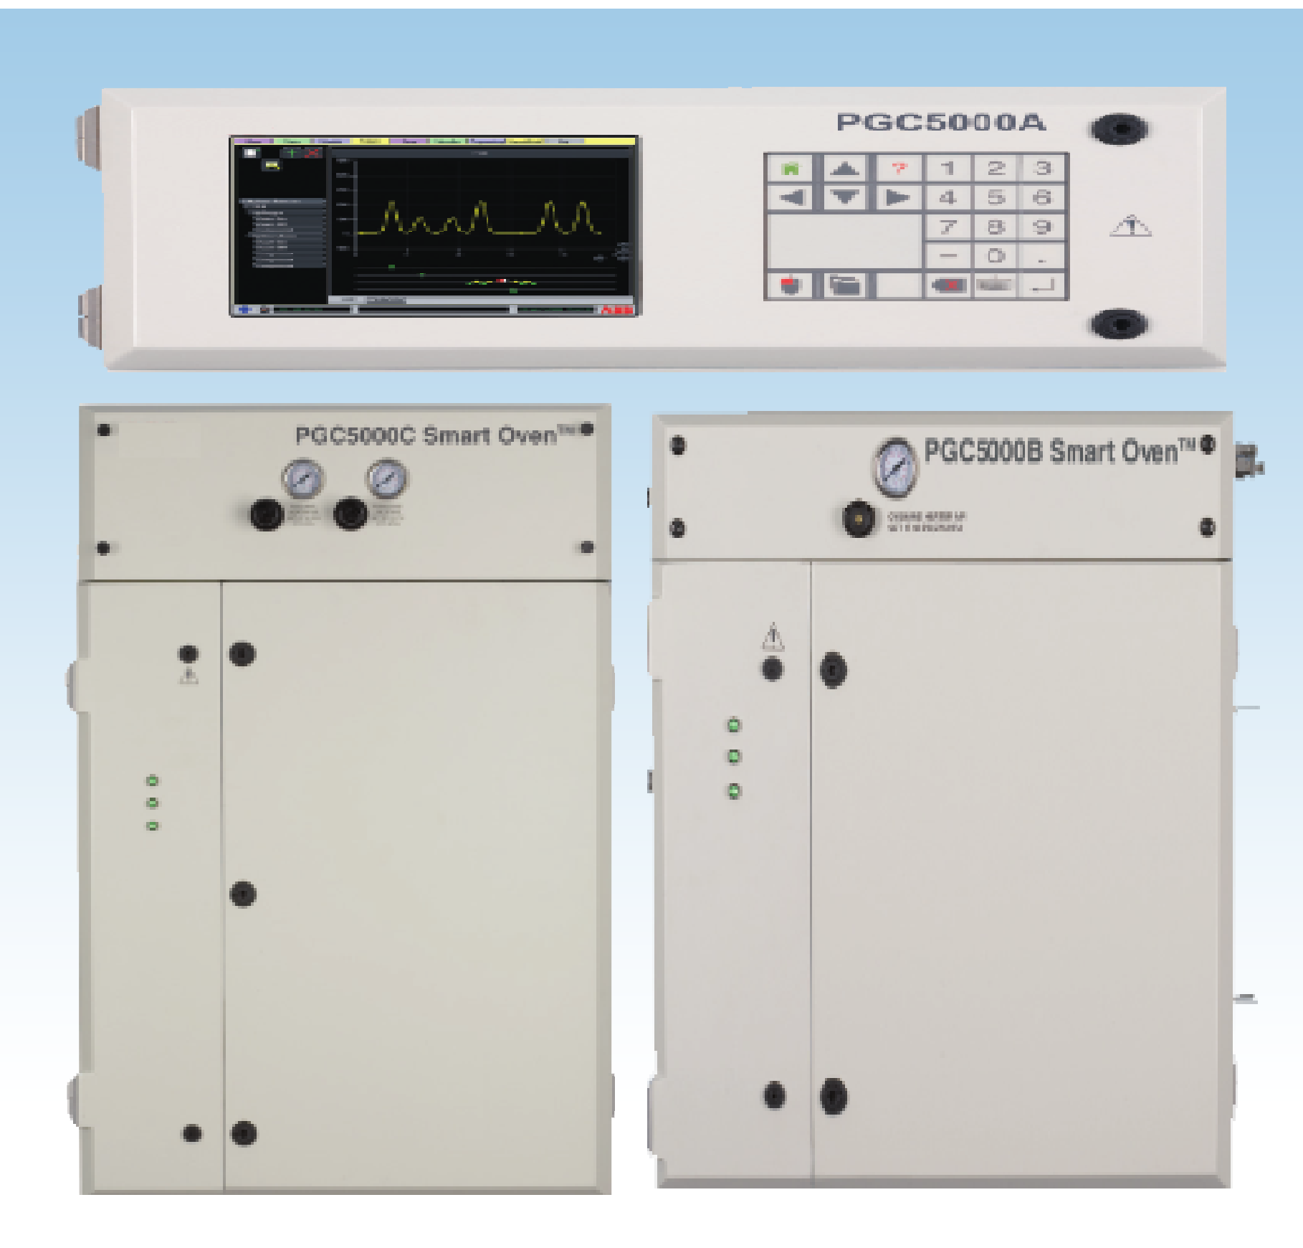
PROCESS ANALYTICAL SYSTEMS
System Integration
ISG design, engineered , build locally & integrate process analyzer system with Analyzer shelter per application and project requirement, flexible enough to accommodate virtually any combination of analytical equipment.
Process Gas Chromatograph
Is a On-line instrument use chromatography technique for separation and analysis of components in the sample stream that can be vaporized without decomposition. PGC has the capability to perform real-time analysis of the chemical composition and provide data to plant operation for optimizing and monitoring product quality.

Slide 12
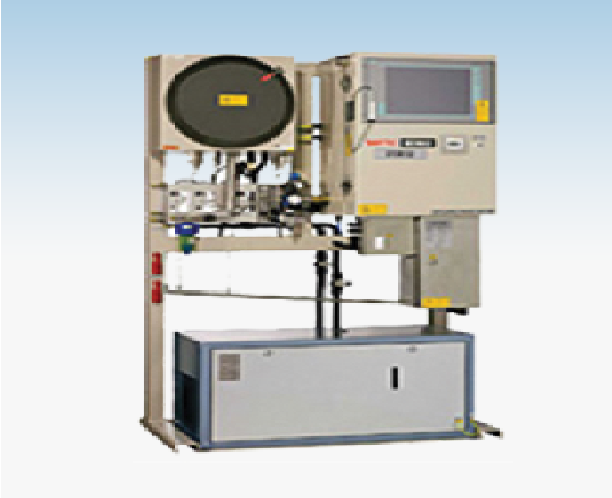
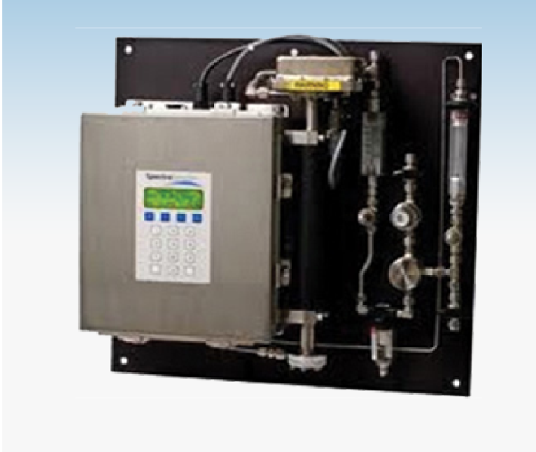
PROCESS ANALYTICAL SYSTEMS
Physical Properties
On-line Physical Property Analyzers used in Refinery and blending process for the continuous measurement in petroleum products , Crude oil and Hydrocarbons application in compliance with ASTM standards.
RVP, Cloud and Pour Point, Flash Point, Distillation, salt in Crude Oil, Viscosity , Freeze Point.
HydroCarbon Gas Analyzer
TDL analyzers provide Trace Level Measurement of components (H2O H2S CO2 C2H2) in Hydrocarbon streams.
TDL technology provides continuous measurement that are accurate, stable and reliable.

Slide 13
PROCESS ANALYTICAL SYSTEMS
Physical Properties
On-line Physical Property Analyzers used in Refinery and blending process for the continuous measurement in petroleum products , Crude oil and Hydrocarbons application in compliance with ASTM standards.
RVP, Cloud and Pour Point, Flash Point, Distillation, salt in Crude Oil, Viscosity , Freeze Point.
HydroCarbon Gas Analyzer
TDL analyzers provide Trace Level Measurement of components (H2O H2S CO2 C2H2) in Hydrocarbon streams.
TDL technology provides continuous measurement that are accurate, stable and reliable.

Slide 14
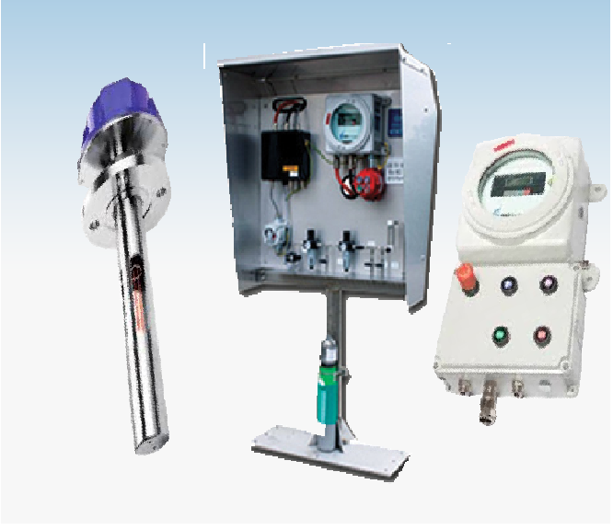
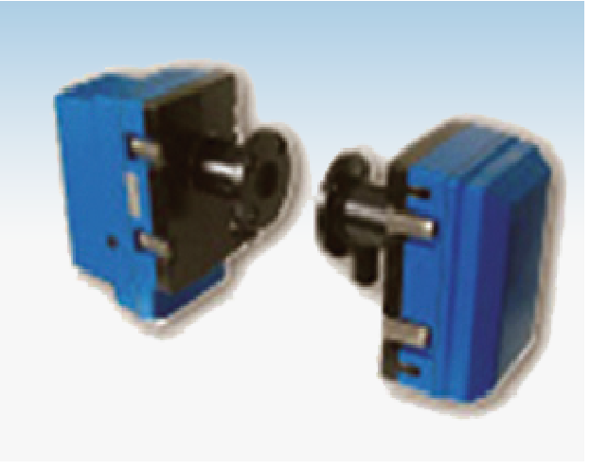
PROCESS ANALYTICAL SYSTEMS
Flue Gas O2 Combustion Analyzers
New tool for use in Combustion Control and Optimization of Energy. Used in Boilers, Furnaces, Incinerators and Environmental Protection Systems. State of Art Zirconium Oxide Technology with dual sensor characteristics provides surpassed performance reliably and integrity.
CEMS and AQMS Analyzer
Analyzers for measuring and monitoring Dust and Opacity used extensively in Power Generation, Waste Incineration, Refineries, Cement Works, Steel and Chemical Processing Plants. Inline with regulatory requirements set out by SPA,ISO,EN,40 CFR 60, or Royal Commission of KSA regulations.

Slide 15
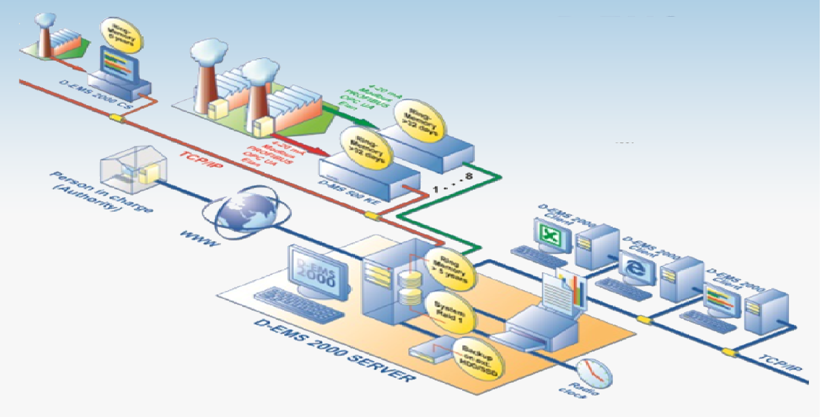
PROCESS ANALYTICAL SYSTEMS
Environmental and Process Data Management System
Modular System for continuous acquisition, long-term storage, calculation and visualization of environmental and process data.

Slide 16
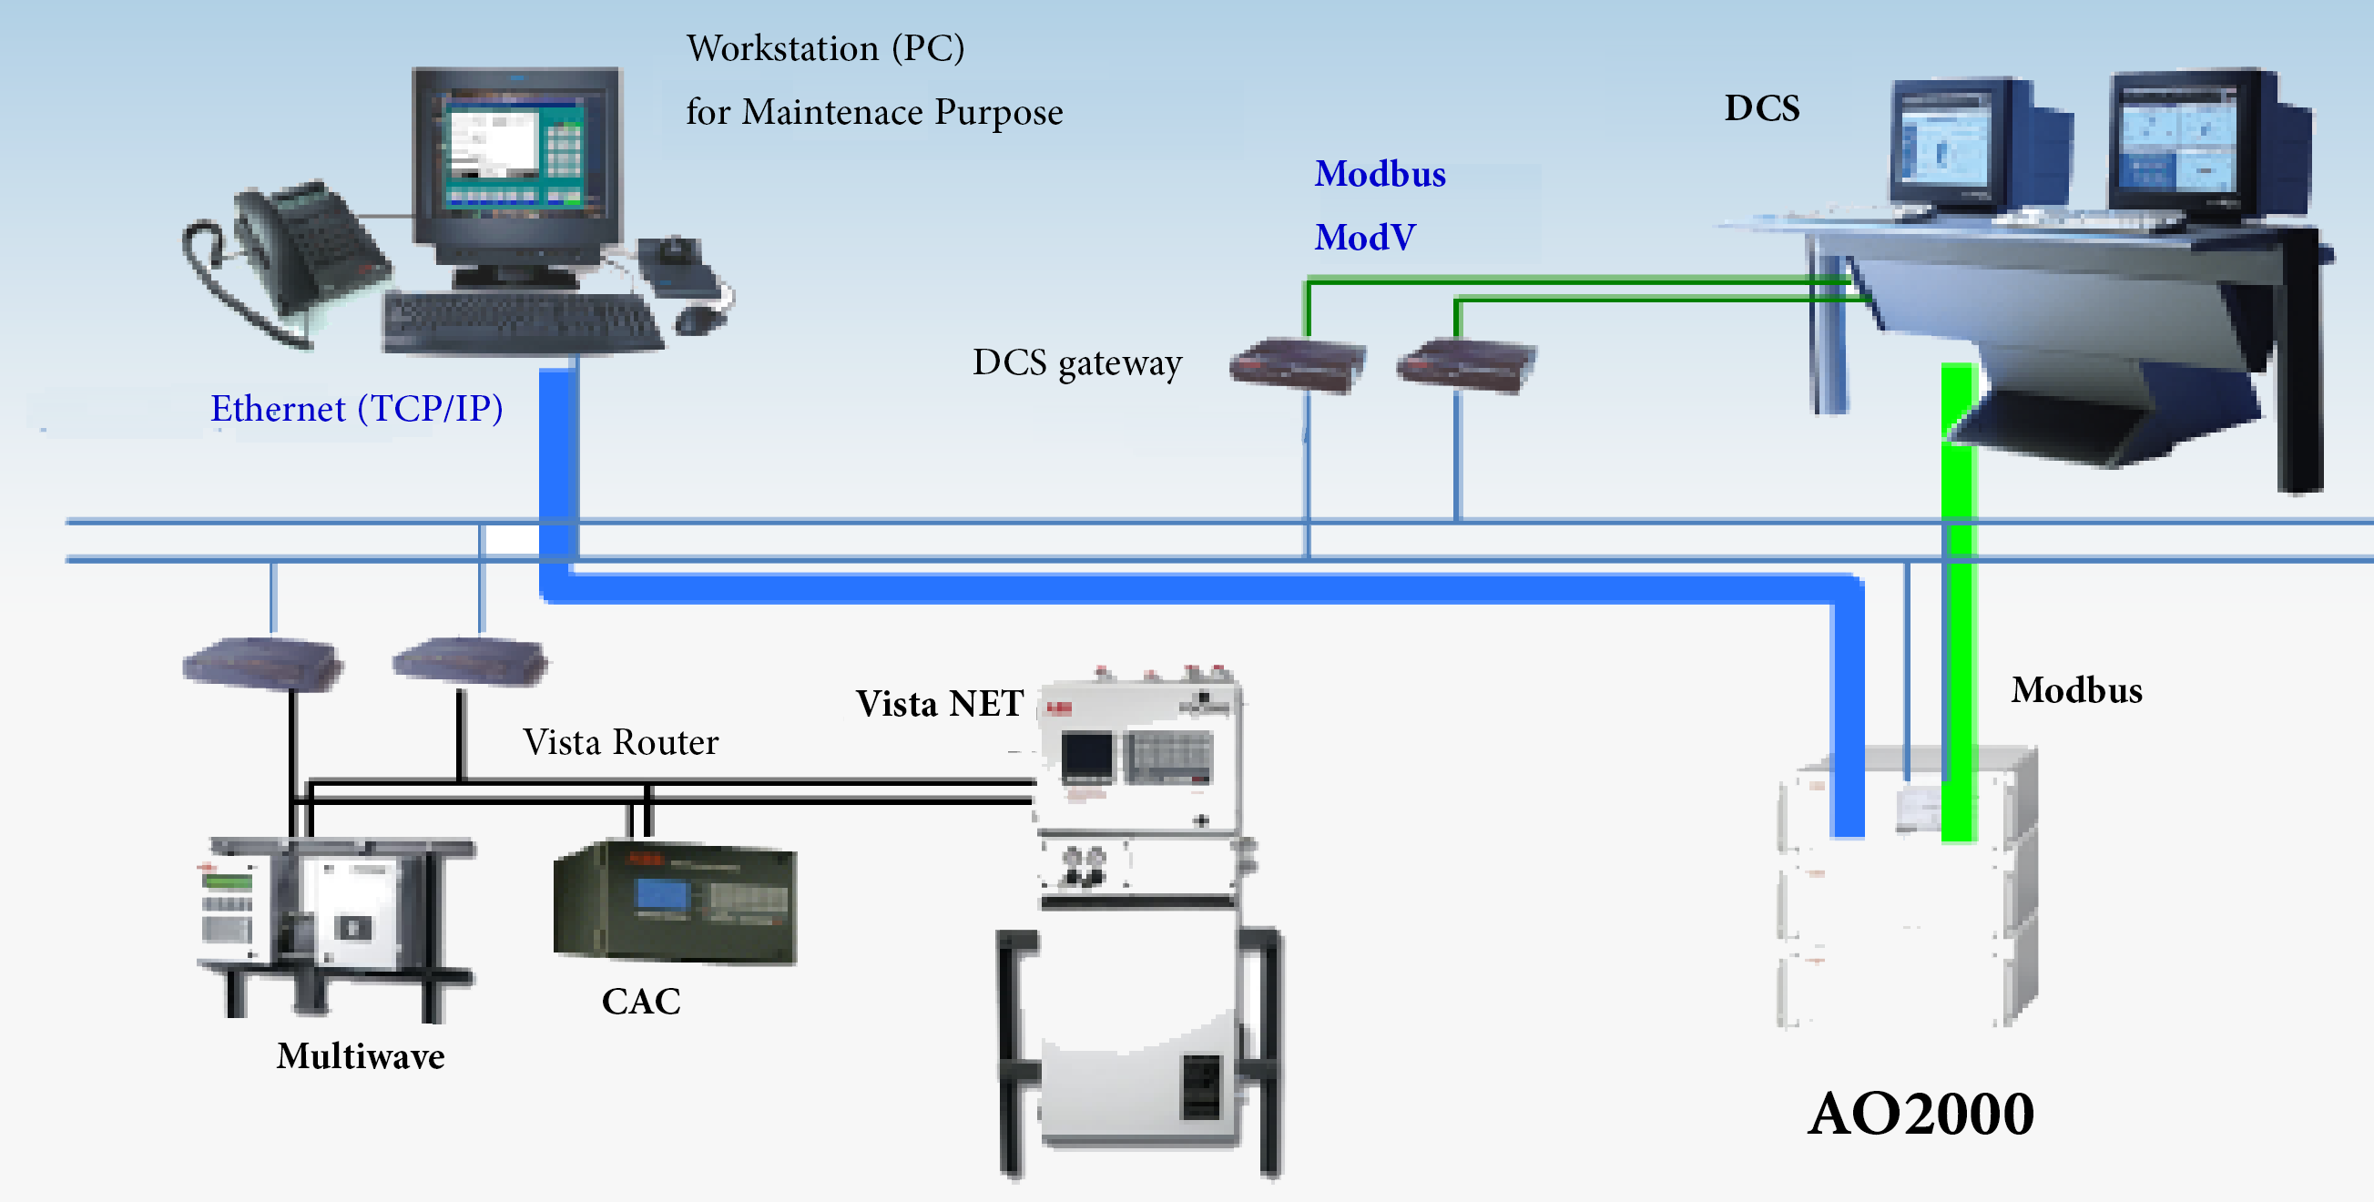
PROCESS ANALYTICAL SYSTEMS
Analyzer Management System
It is to monitor, evaluate and improve the performance of
on-line analyzer in a cost-effective manner. It automatically collect real-time data from analyzer and or DCS, interprets analyzer performance and provides guidance for maintenance.

Slide 17
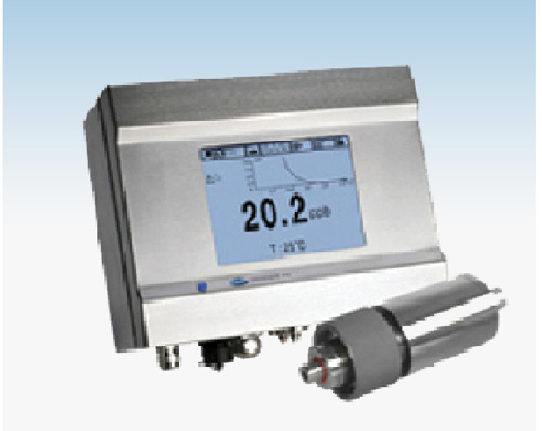
PROCESS ANALYTICAL SYSTEMS
Water Quality Analyzers
Supply of Integrated Sample System and panels for pH, Conductivity and DO2,Silica, Sodium, Phosphate, H2, Chlorine and other customized application for Power Generation and Utilities.

Slide 18
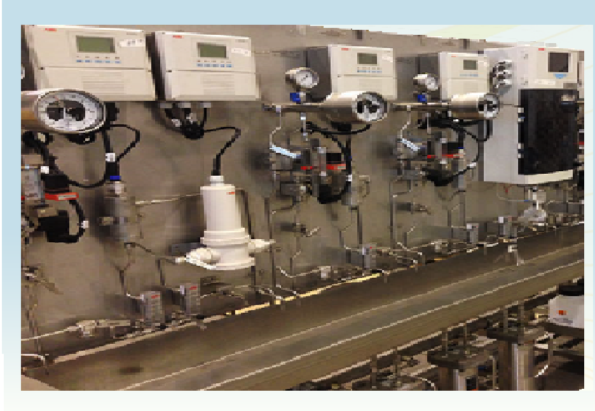
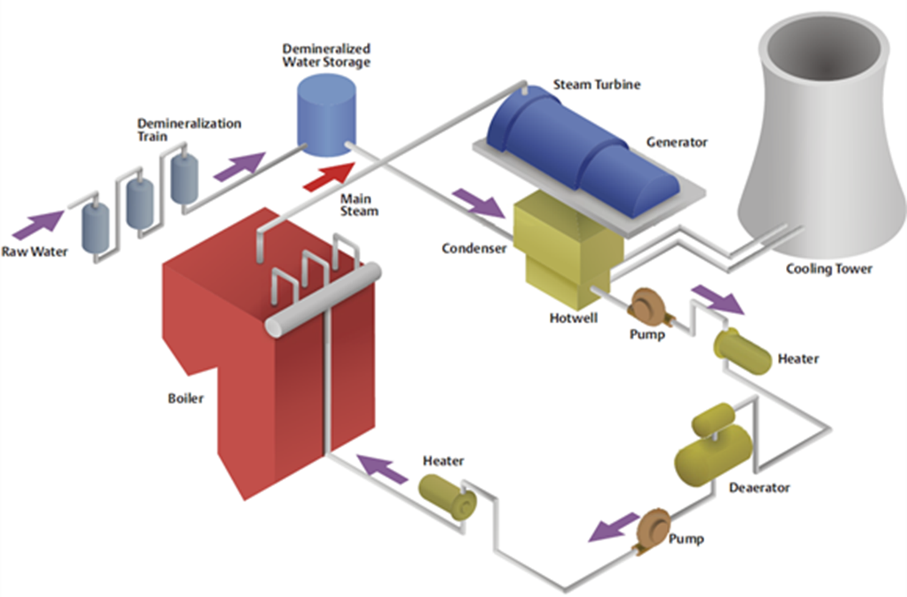
PROCESS ANALYTICAL SYSTEMS
Steam Water Analysis System (SWAS)
Protect boilers from corrosion and scaling effects. Typical components consist of pH, Conductivity, DO2, Silica, Hydrogen and Sodium.
System comprises of wet and dry panels as per design requirements.

Slide 19
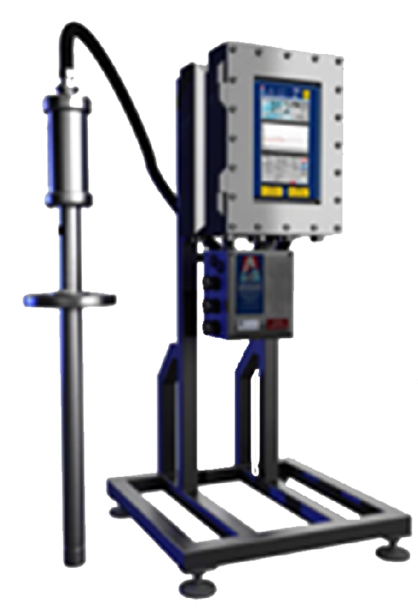
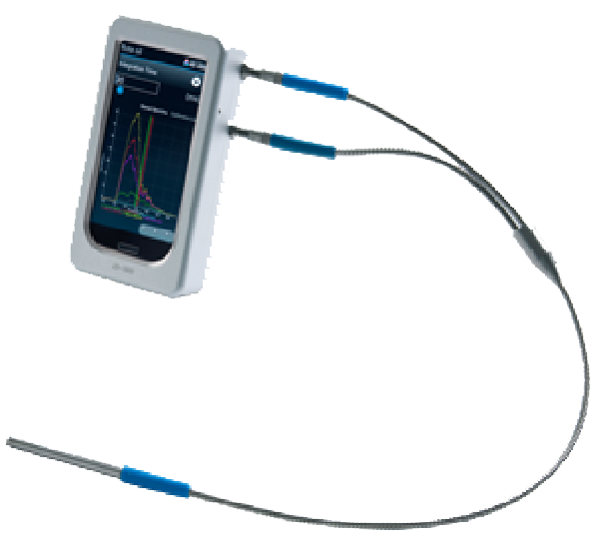
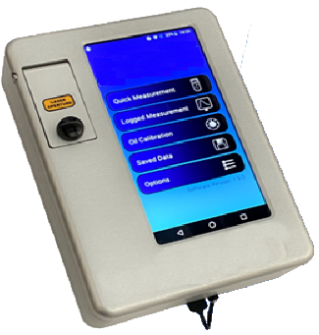
PROCESS ANALYTICAL SYSTEMS
Oil in Water Analyzer
Laser Induced UV Fluorescence detection of oil in water is a rugged and field proven technology.
No Consumable or regular maintenance required. Filed proven in hostile environments..

Slide 20
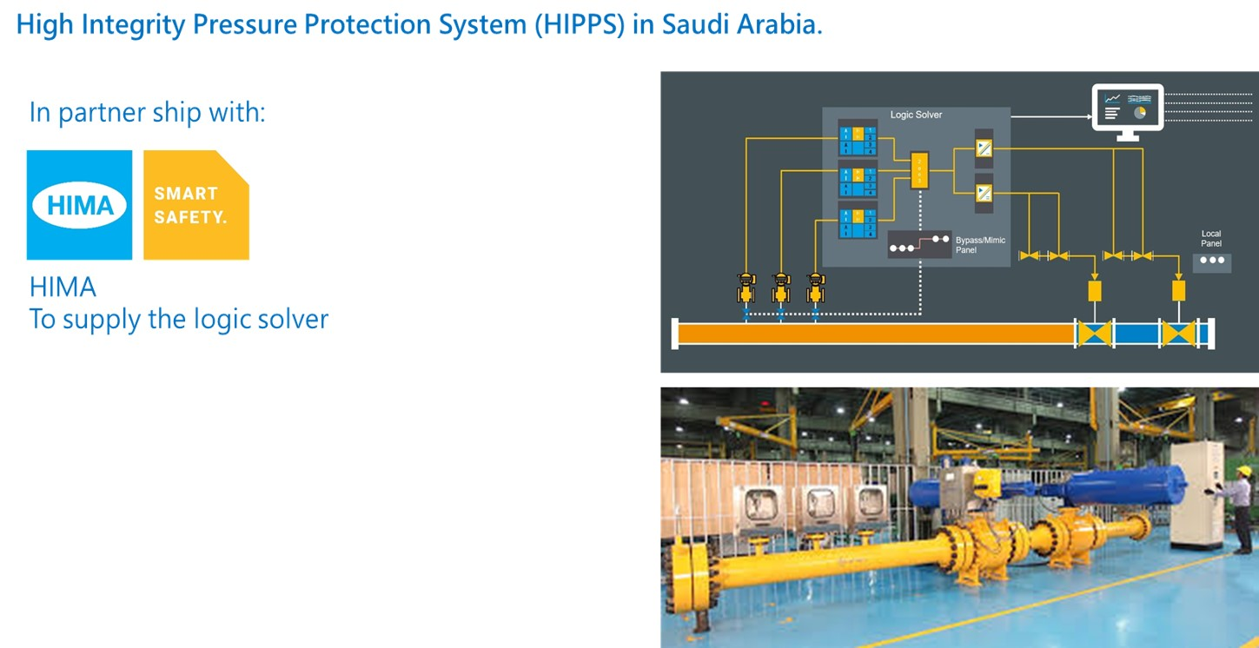
CONTROL & SAFETY SYSTEMS
HIMA offers you everything you need for a complete HIPPS & ESD solution. HIPPS stand for High-Integrity Pressure Protection System (HIPPS). It is the system which prevents over-pressurization of pipelines by shutting off the source of high pressure. HIPPS solution contains excess fluids or gasses in the system instead of releasing them. This increase safety, reduces losses, and prevent emissions, ensuring your plant complies with regulations. HIMA have successfully completed many HIPPS projects for customers around the world; ranging from offshore platforms and LNG plants to oil refineries and gas pipelines including Saudi Aramco SFNY Header project in Saudi Arabia.
Whenever there is extremely high potential risk, the Planar4 controller from HIMA ensures maximum safety. It can be used in high-integrity pressure protection systems (HIPPS) for chemical operations and oil refineries. However, with a switching time of just 2 to 10 milliseconds, it can be also be used in emergency shutdown systems on oil rigs and in extremely time-critical safety.

Slide 21

CONTROL & SAFETY SYSTEMS
ISG Vibration Monitoring Systems
Our product line provides a complete protection, condition, and performance monitoring solutions for all rotating machinery application starting BOP’s up to high application such as big steam turbines.
Our product line has a dedicated ESD room equipped with certified & high quality tools which includes comprehensive range of transducer and associated hardware testers. Full Panel Design and assembly for VMS & CMS and performance monitoring solutions are all done locally at our ISG Factory.
Our Highly-skilled and expert service engineers aim to provide our clients only the best of our support services and aftersales along with FAT & SAT commissioning.
We have 15 years of Experience in reliable, high quality System

Slide 22

INSTRUMENTATION
As the Kingdom advances to modernization where automation plays a critical role, INDUSTRIAL SYSTEMS GROUP (ISG) working as an approved local systems integrator with world renowned automation system leaders such as SIEMENS, HONEYWELL, EMERSON, ROCKWELL AUTOMATION, SCHNIEDER ELECTRIC, etc. the possibilities are endless. ISG provides full-fledged system, from Engineering Design to supplying front-end Instrumentation sensing devices up to the supervisory level SCADA Systems. ISG caters any industry applications. It could be as simple as a small agricultural farm or medium scale manufacturing plants, medical & pharmaceutical laboratories, food & beverage factories up to large scale industries such as SMART Cities, Industrial Oil & Gas Plants etc.
ISG shall continue to strive on becoming the Kingdom’s most trusted partner in realizing the Saudi Vision 2030 and will continue to play its part of building the Kingdom’s future by supplying systems which are proudly “Designed & Built Locally” – upholding excellence & integrity.

Slide 23

INSTRUMENTATION
Wireless Remote Monitoring Units (WRMU)
ISG locally designs & assembles WRMU for Cathodic Protection Applications. With a modular design approach, ISG builds a fully-functional system that is maintenance-friendly & future-proof design. This feat is achieved by the idea of using modular components manufactured by customer-approved vendors that is compatible with almost all industry standard open communication protocols. Leaving behind manufacturer proprietary standards limiting end-customers freedom to universal compatibility.

Slide 24


INSTRUMENTATION
SENSORS
(TCs AND RTDs)
Every Thermocouple and Resistance Temperature Detector (RTD) that we manufacture is designed by global provider of temperature instrumentation, Daily Thermetrics. We understand that with thermocouples and RTDs, it is not the cost of the temperature sensor, but all the costs and time involved in replacing a sensor.
You can simply impress your audience and add a unique zing and appeal to your Presentations. Get a modern PowerPoint Presentation that is beautifully designed. I hope and I believe that this Template will your Time, Money and Reputation.

Slide 25

INSTRUMENTATION
THERMOWELLS
As the most critical part of the sensor assembly, each thermowell must be designed, manufactured, and tested properly to be able to seal against the process at the appropriate design pressure and temperature.
For hydrocarbon service, refiners around the world are increasingly specifying flanged thermowells with full penetration welds.
X-rays and Dye Penetrant Testing falls short of providing a complete volumetric inspection to verify the integrity of the weld. As such, we provide Ultrasonic Testing as a standard inspection procedure for 100% of all full penetration welds performed at our facility.

Slide 26
APPROVAL & CERTIFICATION
SAUDI ARAMCO APPROVAL
CERTIFICATION
Industrial System Group Vendor Code 10053975
Plant Number 30007101
TUV NORD ISO 90001 : 2015
TUV NORD OHSAS 18001 : 2007
QUAY AUDIT BS EN ISO 14001:2015
PRODUCTION QUALITY ASSURANCE 0344

Slide 27


Saudi Aramco Approval

Slide 28

Certification

Slide 29

Certification

Slide 30

Certification

Slide 31

Certification

